Slide 1



An introduction to

Slide 2
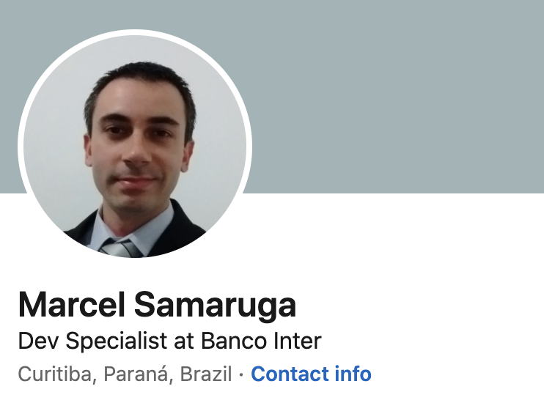


Who am I?
https://www.linkedin.com/in/marcelsamaruga/

Slide 3
Agenda
What is gRPC?
HTTP1.1 vs HTTP2
Protocol Buffers
gRPC APIs
Use Cases

Slide 4
gRPC
Open source project developed by Google in 2015
CNCF
RPC (Remote Procedure Call)
Language agnostic

Slide 5
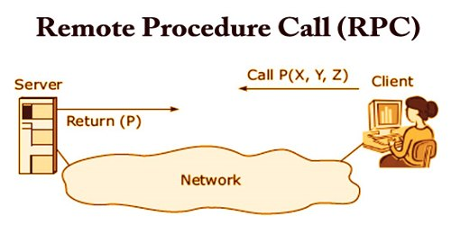
RPC

Slide 6
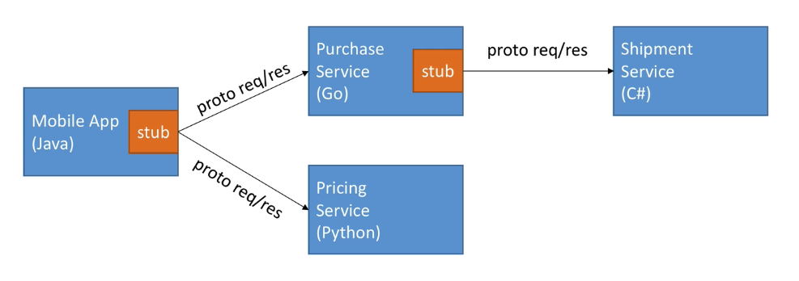
gRPC

Slide 7
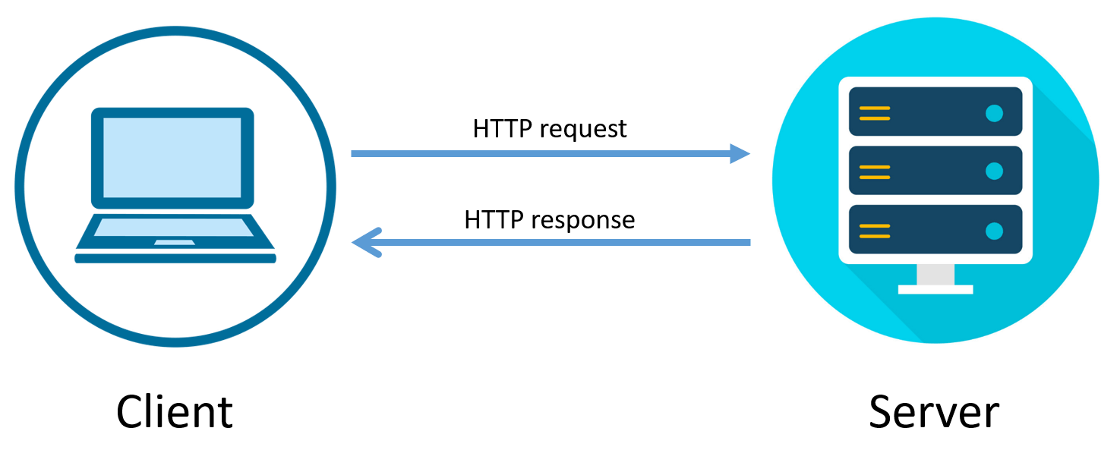
HTTP/1.1
Request <-> Response

Slide 8
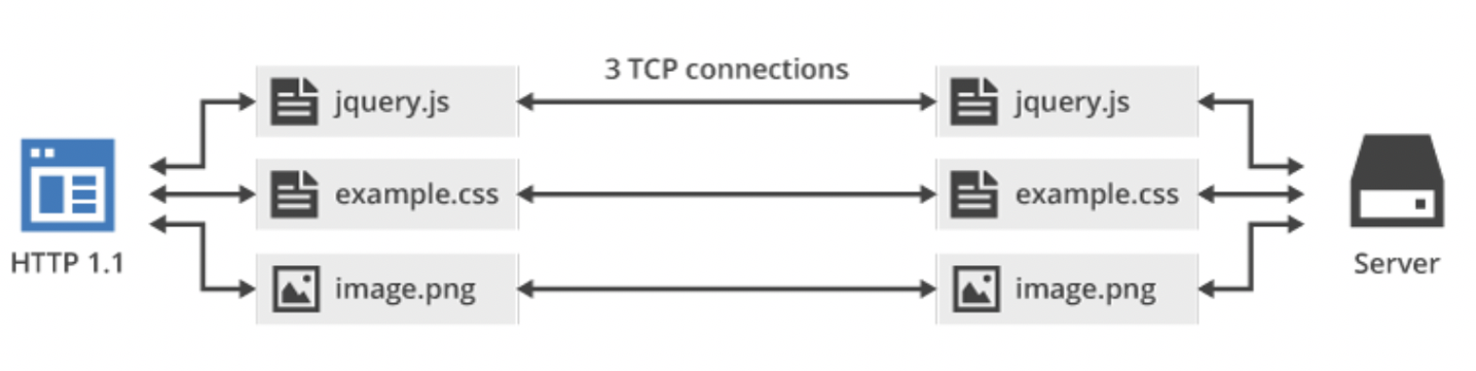
HTTP/1.1
Request <-> Response

Slide 9
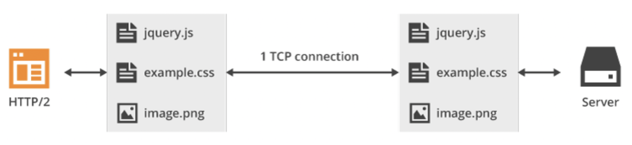
HTTP/2
1 TCP Connection – Multiplexing – Server Push

Slide 10
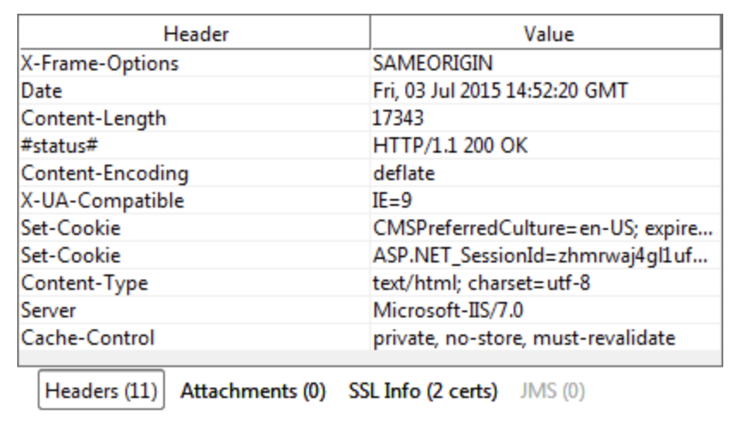
HTTP/1.1
HTTP Headers

Slide 11
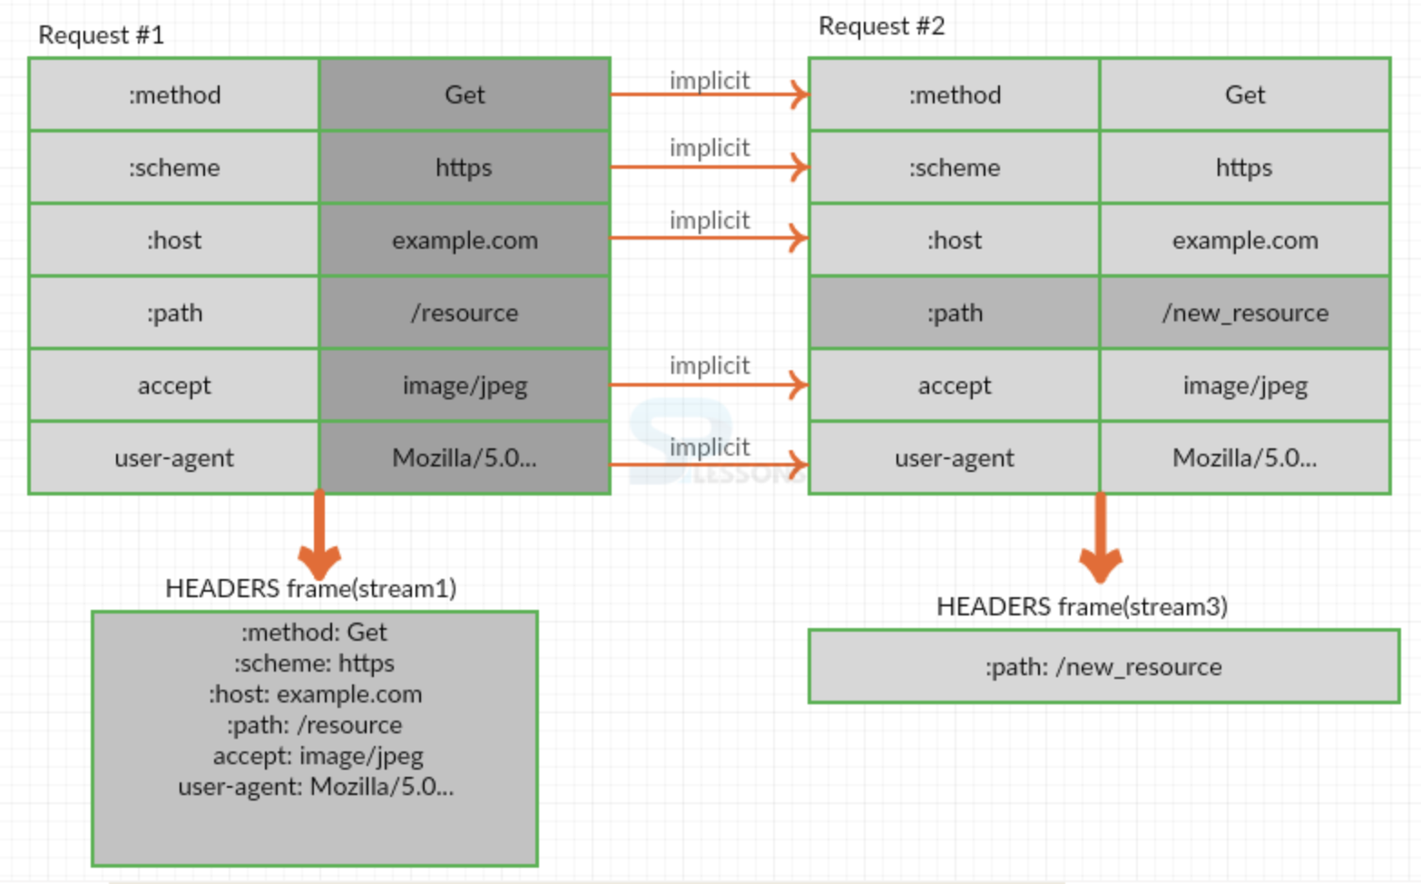
HTTP/2

Slide 12
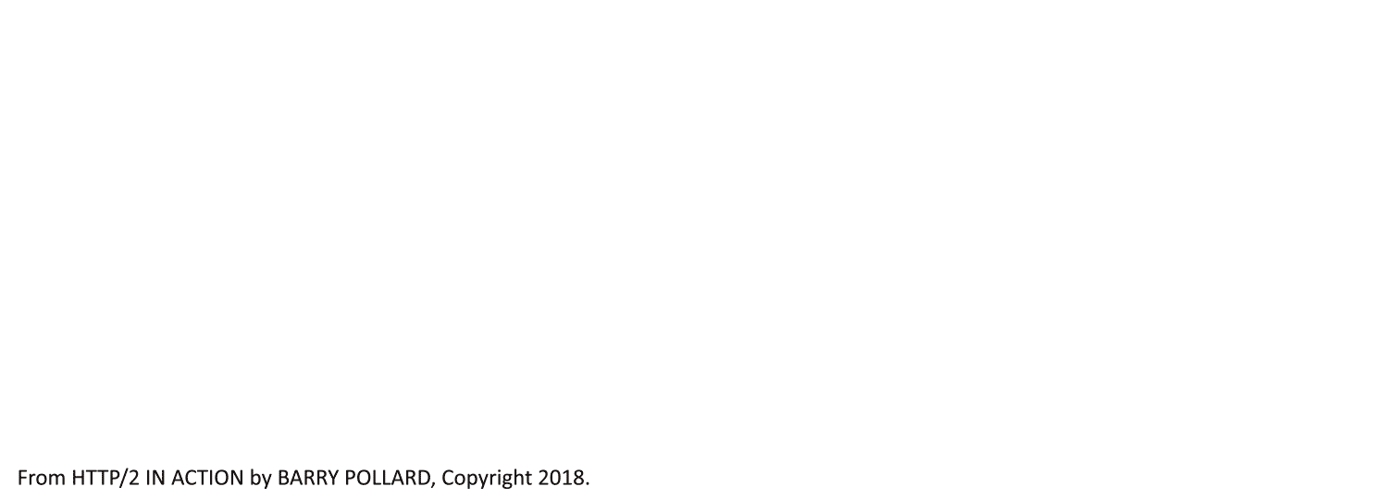
HTTP/1.1

Slide 13

HTTP/2

Slide 14

HTTP/2 (Server Push)

Slide 15
HTTP/1.1 vs HTTP/2
https://imagekit.io/demo/http2-vs-http1?utm_source=blog&utm_medium=blog&utm_campaign=Blog

Slide 16
Protocol Buffers
Serialize/Deserialize structure data
IDL
Super fast communication
Provides client libraries automatically
Java
Go
C#
Javascript
Ruby
C++
Dart
Kotlin
Python
Objective C
PHP

Slide 17
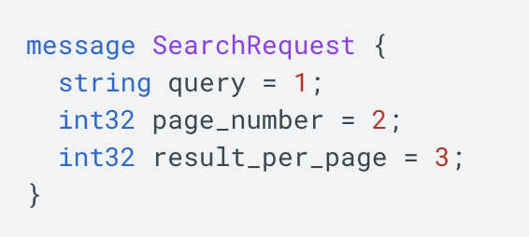
Protocol Buffers

Slide 18
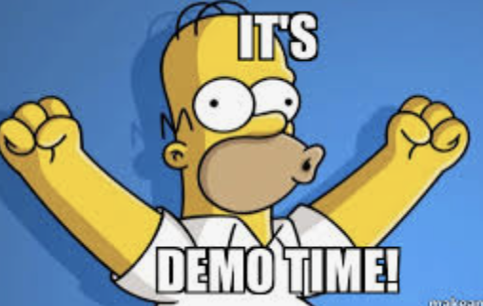
Protocol Buffers

Slide 19

Protocol Buffers (caution)
Default values
-> google/protobuf/wrappers.proto

Slide 20
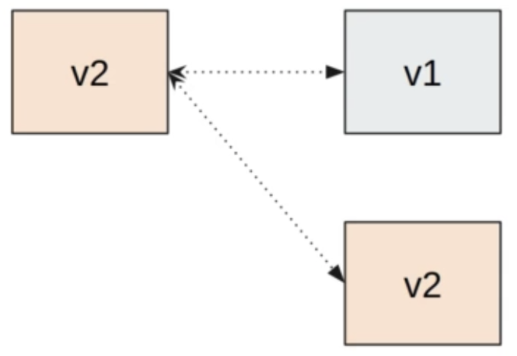
Protocol Buffers (caution)
Reusing indexes

Slide 21

Protobuf - Do
1-15 Frequently Fields
New fields
Reserved

Slide 22

Protobuf – Dont’s
Reorder fields
Warning: change types

Slide 23
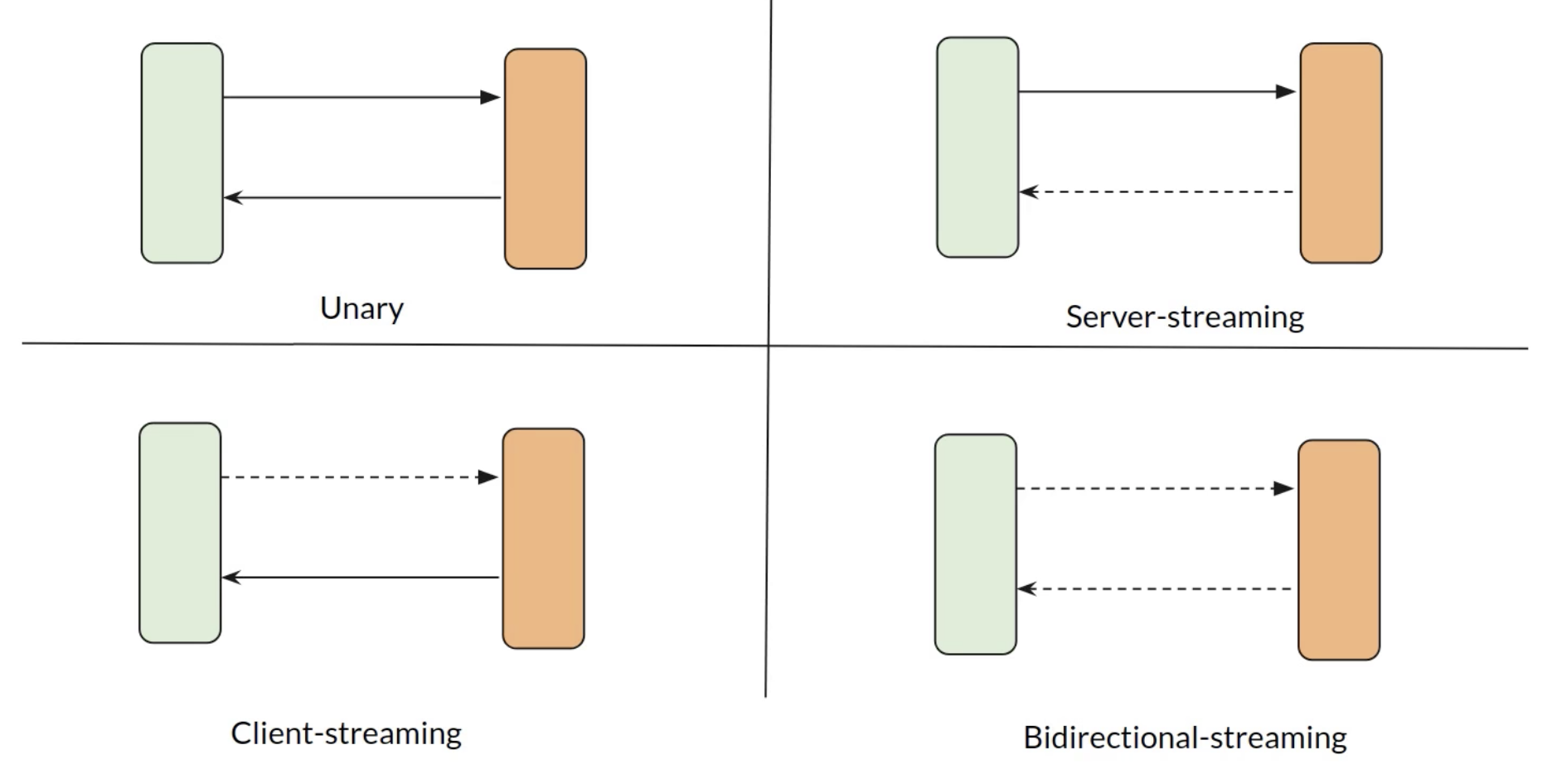
gRPC APIs

Slide 24
gRPC APIs

Slide 25
gRPC Showcase
https://www.cncf.io/case-studies/?_sft_lf-project=grpc

Slide 26

Questions?

